Slide 1
Airedale Blunt Chest Trauma Pathway
Dr. Alexandra Danecki
Dr. Alice Binbay
Dr. Abhijit Singh
Lewis Woodhouse
Notes:
AD to introduce. Highlight team approach to the pathway. Ongoing engagement – achieved because our team care about this project because we have seen some tangeable benefits for our hard work. Invited to share.
Lewis – specialist respiratory physio, project lead on pathway

Slide 2
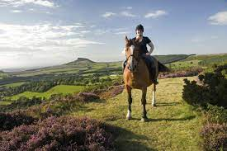
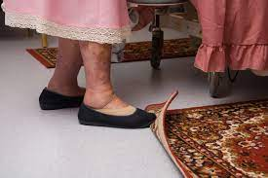
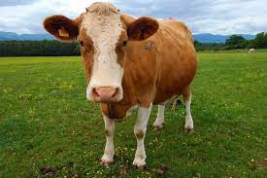
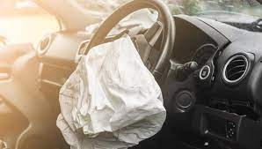
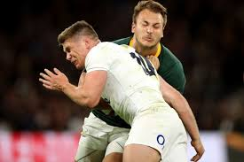
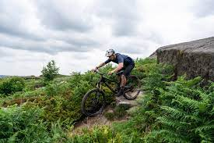
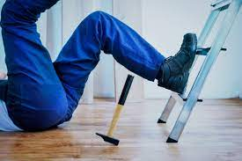
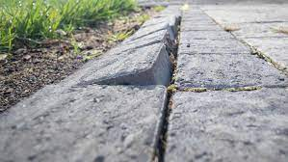
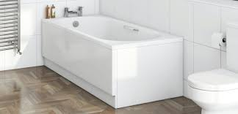
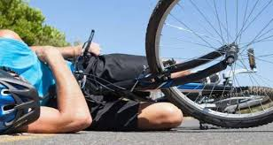
The problem
Notes:
AD. Common. TARN: 2nd most injured body part. High mechanism vs low mechanism. High risk groups vs low risk groups. Different ways to present: 999 / self present / MIU / time of injury / delayed. Sometimes isolated injury, sometimes part of a multiple injury pattern, often in parallel with medical illness / collapse / frailty. Dogma of ‘we do nothing with rib fractures anyway’. Poor appreciation of the morbidity associated with chest injuries. We are a TU. No thoracics. No dedicated Major Trauma Ward. We need to ensure our patients aren’t receiving substandard care compared with that delivered at the MTC. We needed to provide assurance and the only way we could see if we had a problem was if we looked for one…

Slide 3
The patient
87F.
Fall at home, from standing.
RR 22, sats 94%RA, HR 90 BP 139/88.
Seen by junior in ED, noted to be SOB
CXR: reported as ?rib fractures ?infection
Admitted under the medical team, prescribed Abx
Next day had a CT: 5 Rib fractures with flail segment, pulmonary contusions, small haemothorax
No therapy or acute pain review.
Outcome: secondary pneumonia. LOS 14/7. Persistent restrictive lung disease.
Notes:
AD

Slide 4
The baseline audit
October 2019-December 2019
CT in the ED | 72%
Surgical admission | 50%
Medical admission | 50%
Seen by Therapy Team (overall) | 44%
Seen by Therapy Team: Surgical admission | 66%
Seen by Therapy Team: Medical admission | 22%
Rate of secondary pneumonia | 27%
Hospital LOS (mean) | 10.3 days
Inpatient Mortality | 5.5%
Notes:
AD

Slide 5
Notes:
AD

Slide 6
The Quality Improvement Project
Notes:
AB.
Description of what a QIP is

Slide 7
The plan
To implement an evidence based Blunt Chest Trauma Pathway:
To improve quality of care through standardisation of practice.
To identify the patients who would benefit from inpatient treatment.
To reduce secondary pneumonia and LOS in admitted patients.
To proactively treat the patients who are discharged to reduce secondary complications and returns to the ED.
Notes:
AB. Note bottom line the other arm of the improvement work looking at ED discharges
Primary and secondary outcome measures
Balance measures

Slide 8
Stakeholders
Blunt Chest Trauma Pathway
Patients
Radiology
General Surgery
Acute Pain Team
Critical Care Team
Therapy Teams
Pharmacy
Major Trauma Governance Group
MTC Thoracic Surgery
ED
Acute Medicine
Notes:
AB.
Engagement with specialty teams

Slide 9
The agreed principles
All adult patients admitted with blunt chest trauma will:
be managed on a defined Blunt Chest Trauma Pathway
receive appropriate analgesia
be provided with an incentive spirometer and be encouraged to use it
have a CT thorax to fully quantify their injury
have a Chest Injury Severity Score* calculated to guide their care
be referred to chest physio from ED (via the Major Trauma Icon)
be referred to the Acute Pain Team from ED
be admitted under surgery (ward / HDU / ICU)
have a rehabilitation prescription completed
*Battle C, et al. +Predicting outcomes after blunt chest wall trauma: development and external validation of a new prognostic model. Crit Care. 2014 May 14;18(3):R98.
Notes:
AB

Slide 10
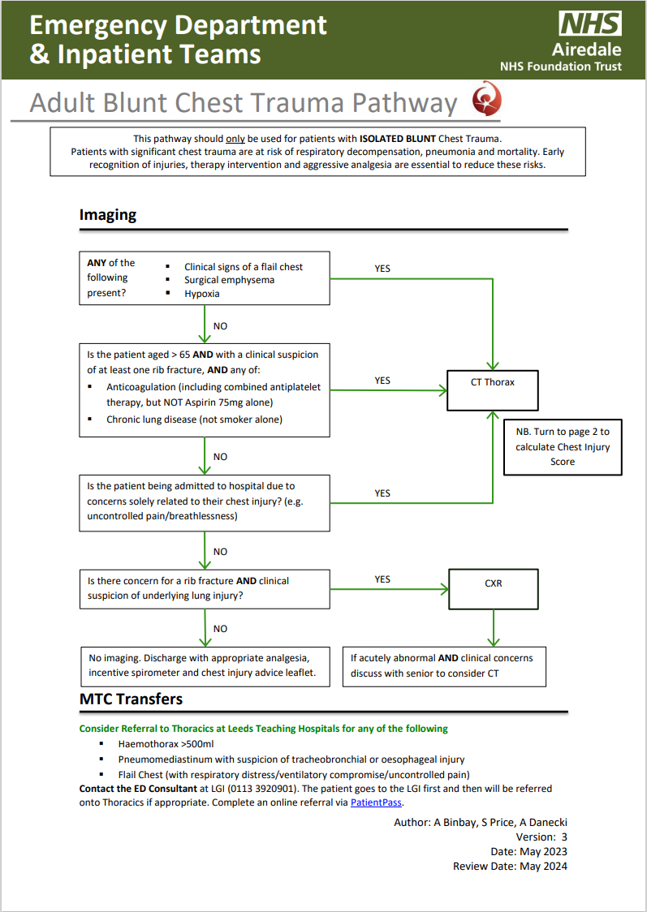
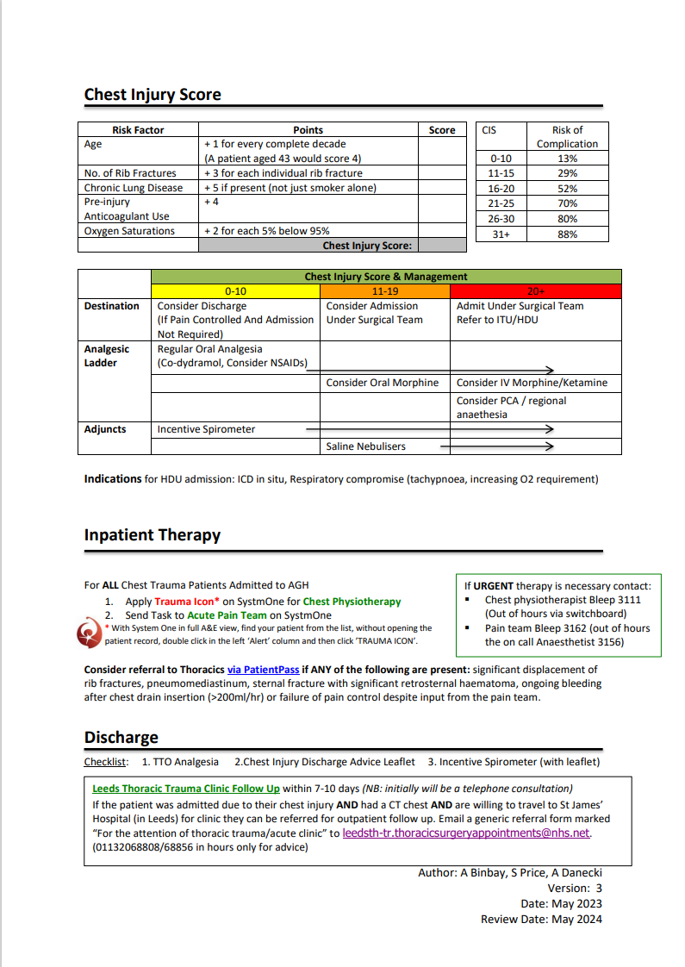
Notes:
AB. Detail expanded on next few slides

Slide 11
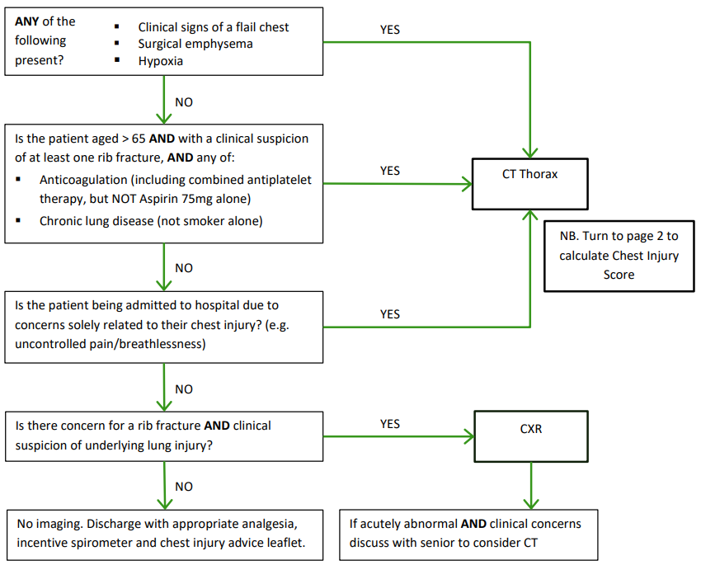
Imaging
Notes:
AB
Focus on second imaging box
Reference back to case study at start

Slide 12
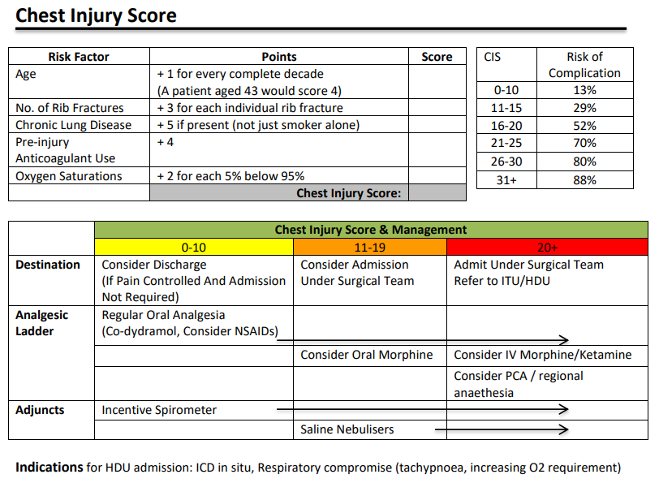
ED Risk Stratification
Notes:
AB. Patient from the case study would have had a CIS of 34 (age, 7 rib fractures (2 flail), sats <95), would have given an 88% risk of complications, and generated a APT / PT ref and discussion with HDU for surgical admission to crit care.

Slide 13
Inpatient therapy
Notes:
AB

Slide 14
Hospital Discharge
Notes:
AB

Slide 15
Getting it out there
MDT simulation
ED Induction
ED MG / junior / ACP teaching
Therapy team study day
Major Trauma Governance Group
Clinical Site Managers
Champions in the ED
Champions on the wards (Therapy Team)
Posters
Notes:
AB

Slide 16
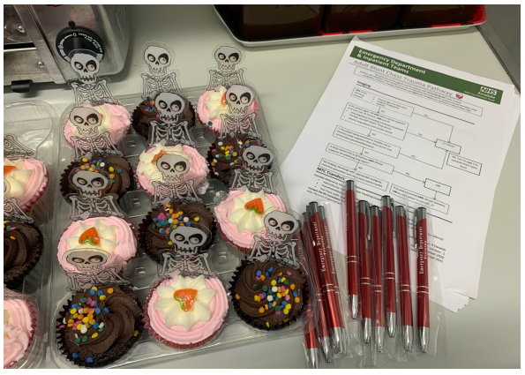
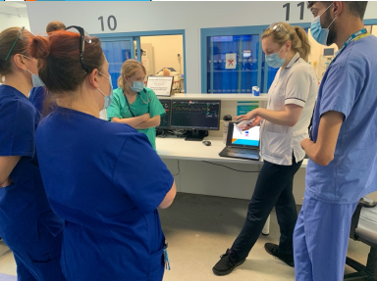
Notes:
AB

Slide 17
Therapy- Identification of Patients

Slide 18
Ongoing Improvements
Amendments to our Respiratory Questionnaire following an audit of the therapy service. Utilising a drop-down menu specifically for Chest Trauma patients;
Mechanism of Injury and Details of Injuries/ Complications
Pain Team Review/ appropriate analgesia prescribed
Prompt to start the Rehabilitation Prescription
Appropriate recording/ documentation of ISS
Audit/ follow up chest trauma patients 3-months post discharge

Slide 19
Education and Training
IST- New physiotherapists to the trust
IST- Ongoing training throughout the team, including chest trauma and on-call criteria
Training of ED staff, including use of incentive spirometer
Making other professionals aware of the pathway, including occupational therapists, nurses and ward staff
Periodic Audit of our chest trauma caseload, to ensure we are providing effective care and continuously improving our service for our patients

Slide 20
Ongoing audit cycle
2019 – pre-implementation
2021 – post-implementation
2023 – Pathway embedded into practice
Notes:
AD

Slide 21
Spoiler alert…
Notes:
AD

Slide 22
The Results (Interventions)
Notes:
AS. Narrative of some of the detail of the re-audit. May want to give narrative of ages, reasons why not full compliance with CT / surgical admission. Explain analgesia not recorded on earlier audits – this measure refers to the provision of appropriate analgesia, not necessarily the activation of the APT. etc

Slide 23
The Results (Patient Outcomes)
Notes:
AS. Stars are animated to highlight the key results.
3 month follow up of all patients – no returns with complications, no additional complications identified in primary care

Slide 24
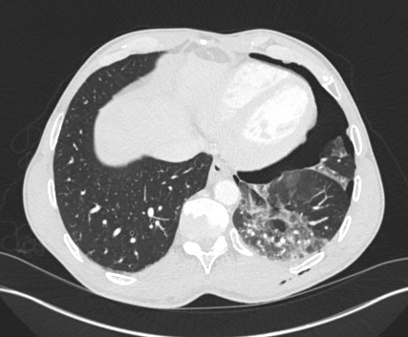
Case Study
52M fall from mountain bike
Triaged as ‘Trauma P2’> Consultant assessment on arrival to ED. Noted to have surgical emphysema L chest.
Trauma CT: 4 L sided rib fractures. Moderate PTX.
CIS 17
Morphine / APT referral. Trauma icon applied in ED
Chest drain inserted
Transferred to surgical ward
Seen same day by chest physio and APT
Early mobilisation, incentive spirometry, ACBT, Supported cough.
Referred to DayOne Trauma Charity
Discharged day 3 with OP follow up in thoracics clinic.
Notes:
AD. ACBT ‘Active Cycle of Breathing’ therapy

Slide 25
Areas for future development
Review analgesic strategy ? Regional blocks- ESPB / SAPB
‘Dynamic’ Pain Scoring
Early mobilisation on the ward: empowering nursing staff
Explore use of ‘Virtual Ward’ for patients with CIS 12-15
Amend the RP checklist to include signposting to DayOne Trauma Charity.
Explore role for community MSK therapy follow up after discharge.
Notes:
AD

Slide 26
Conclusion
Notes:
AD. Radical improvements in practice and outcomes since implementation of the Airedale Adult Blunt Chest Trauma Pathway. A lot of work from lots of people to get it this far. Still lots of work to do to make it even better. Thank you to the network for inviting us to present out pathway, and we have provided some inspiration for improvement in other units.

Slide 27
Questions?
Alexandra.Danecki@nhs.net
@AlexDanecki
Lewis.Woodhouse@nhs.net

